Slide 1

It’s tragic that a special life can be lost in such little time.

Slide 2
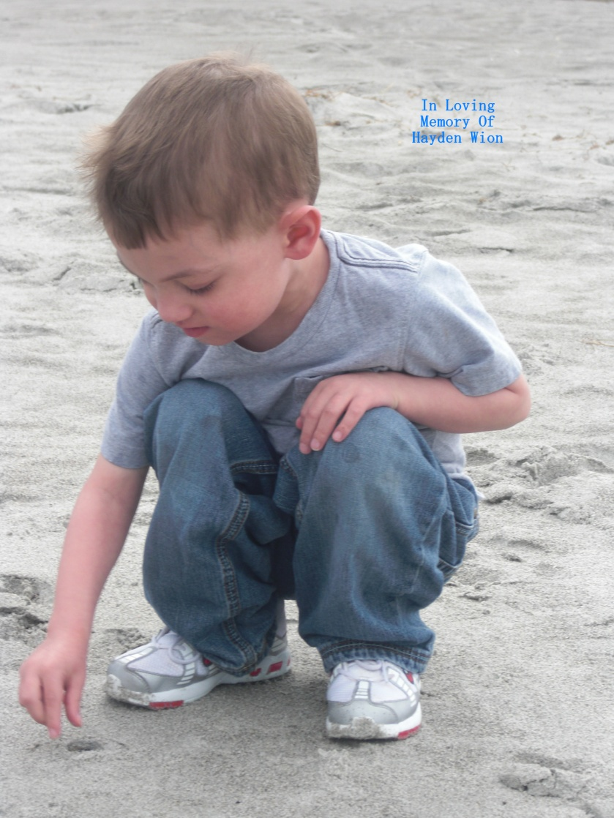
Sometimes I Wonder If I’d ever make it through……
…Through this world without having you…
Just wouldn’t have a clue.

Slide 3
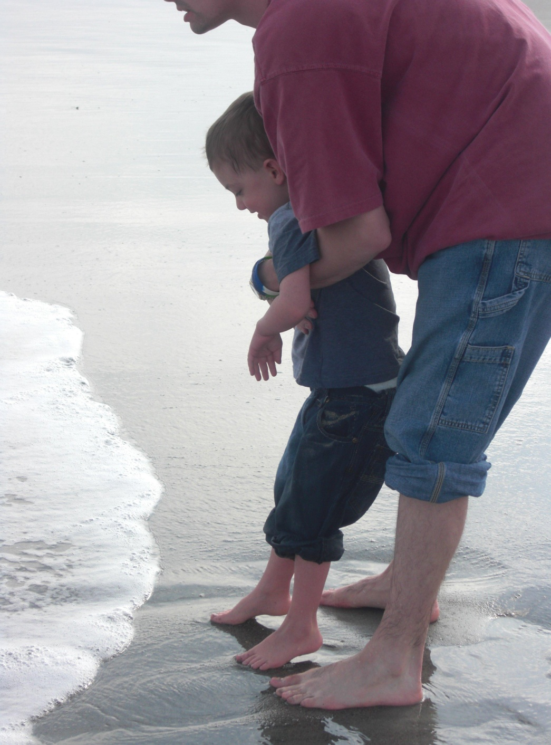
Cause times it seems the like the world’s closing in on me………
And there’s no way of breaking free….
And then I see you reach for me….

Slide 4
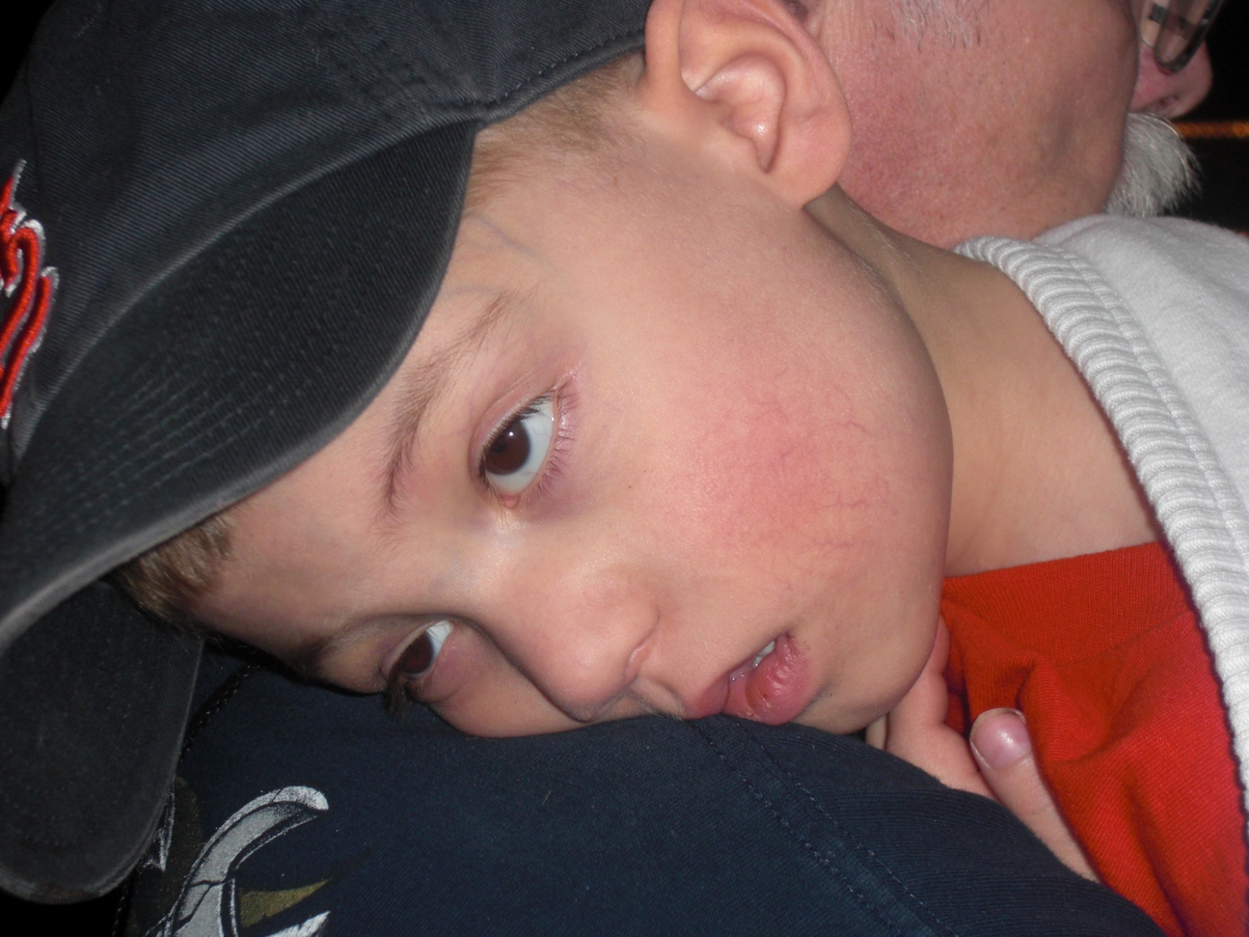
Sometimes I wanna give up…..
Wanna give in….
I wanna quit the fight…

Slide 5
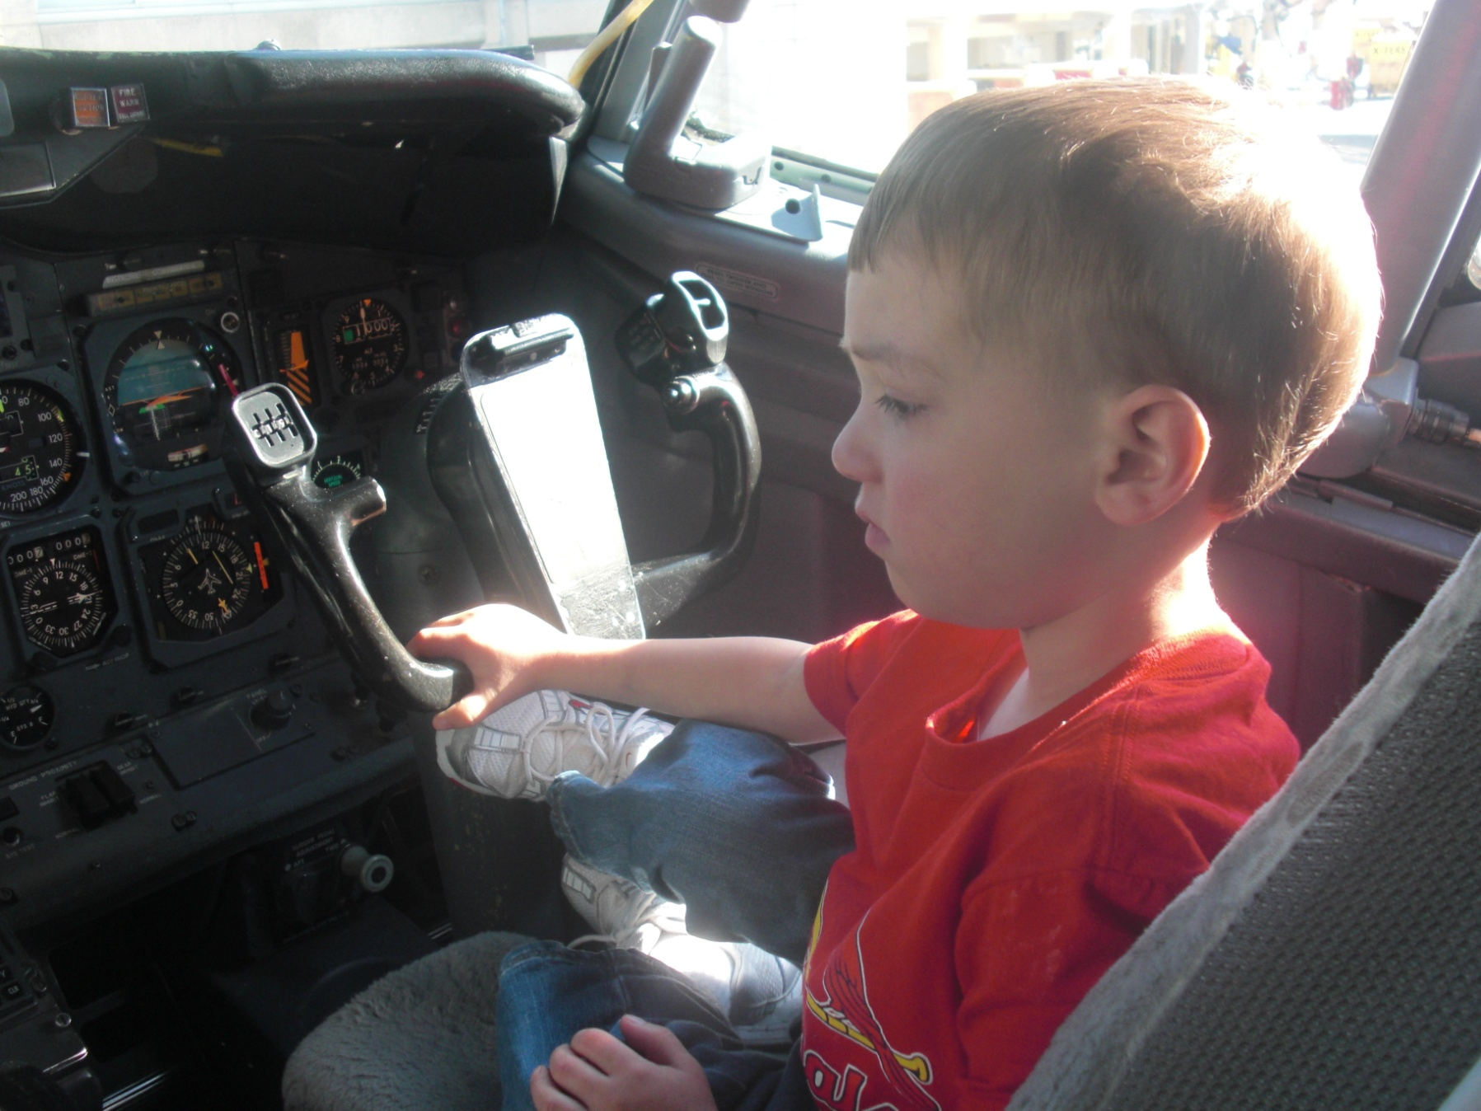
And then I see you baby…….
And everything’s alright.
Everything’s Alright…

Slide 6
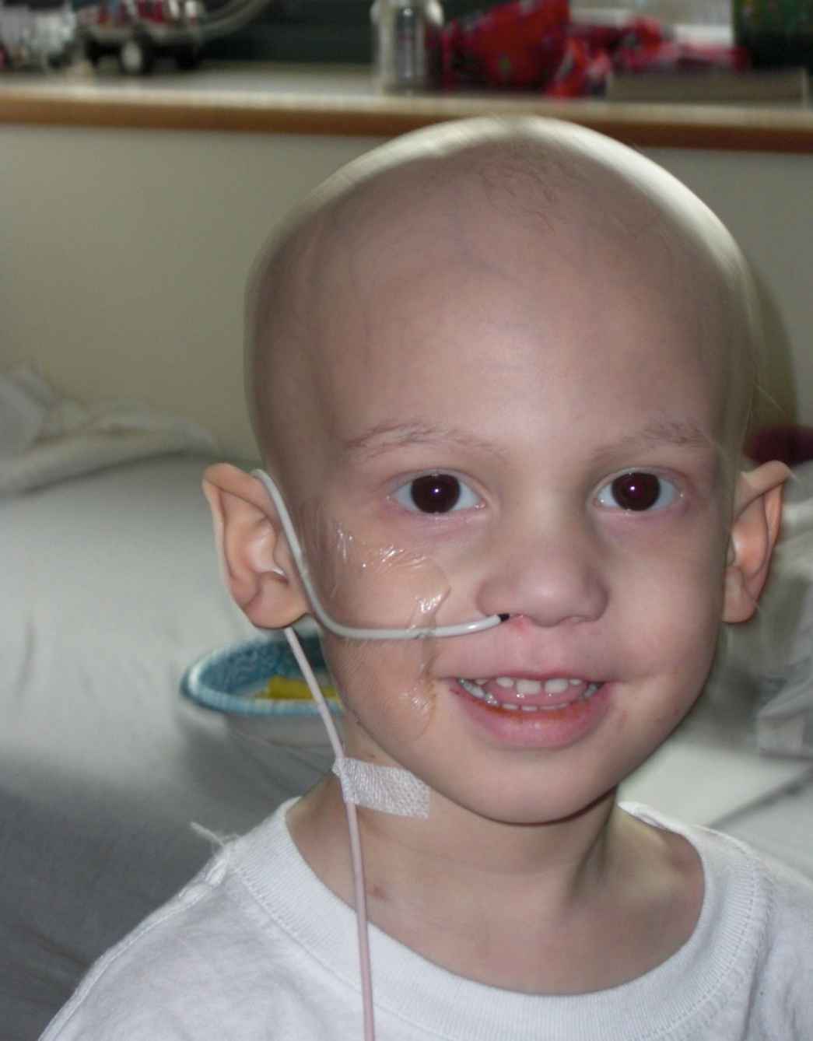
When I
See You
Smile.

Slide 7
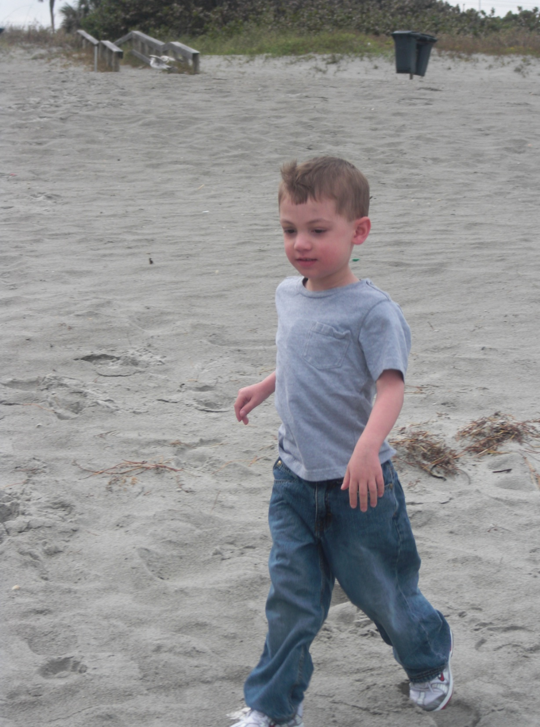
I can face the world…
When I See You Smile……
You know I can do
anything…

Slide 8
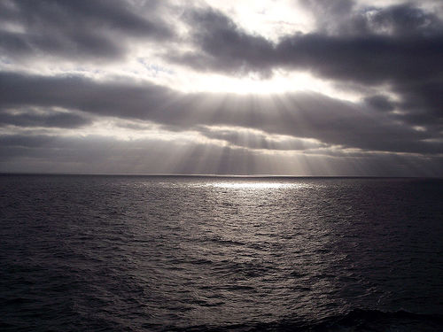
I see a ray of light …

Slide 9
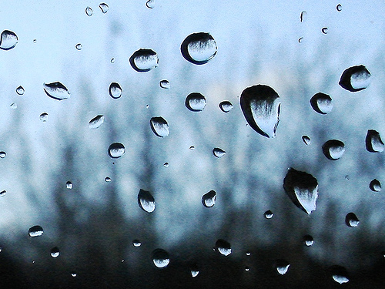
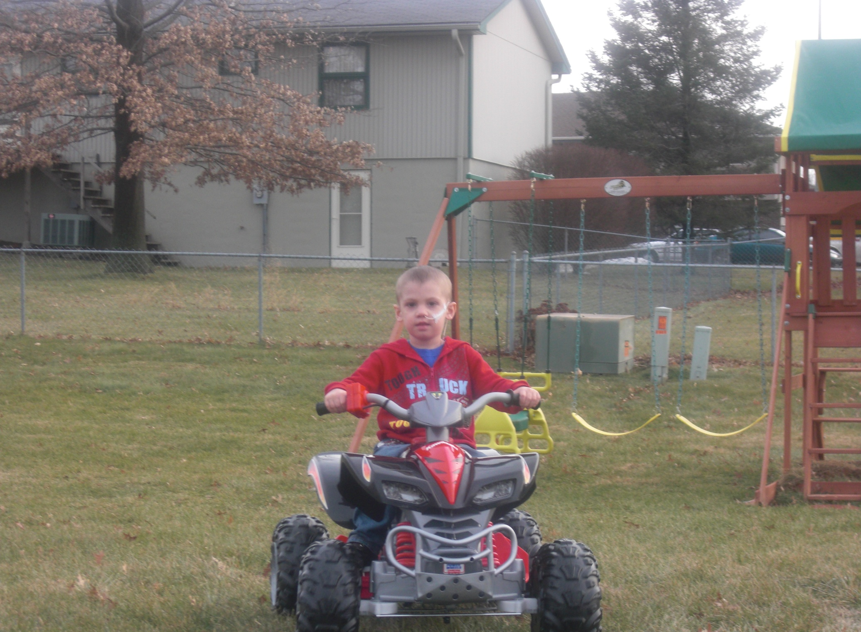
When I See you Smile.
I see it shining right through the rain……………….

Slide 10
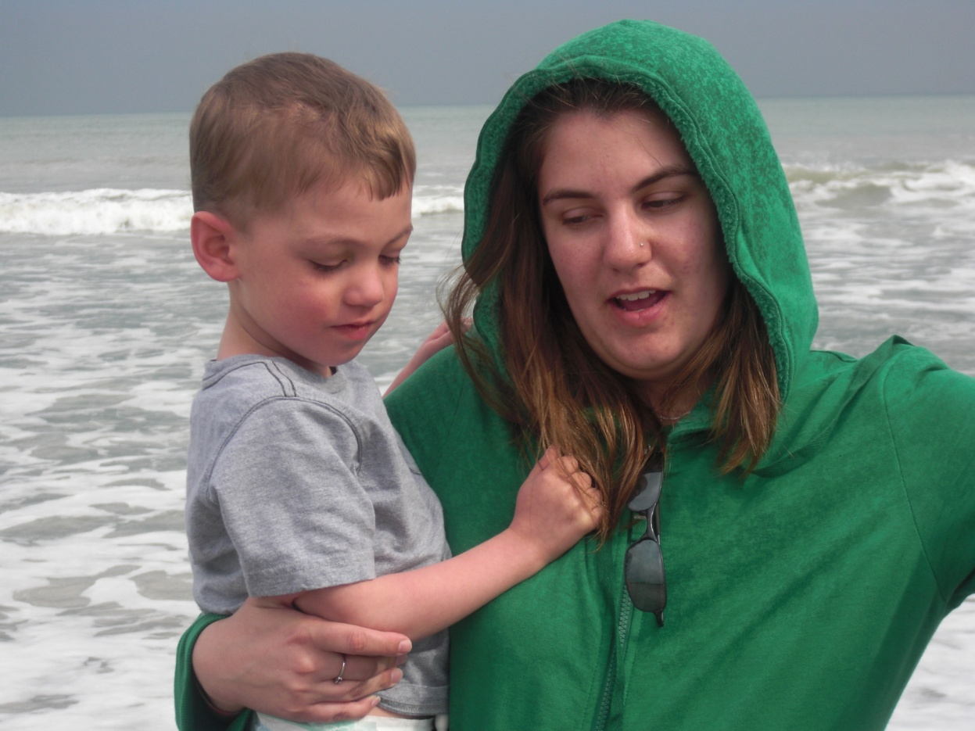
Baby when I see you smile…..
At me.

Slide 11
Baby there’s nothing that this world can do…
What the touch of your hand can do…
It’s like nothing that I ever knew…

Slide 12
Hey..
And when the rain is falling..
I don’t feel it..
Cause you’re here with me now..

Slide 13
I wanna ask you baby…
It’s all I’ll ever need.
All I’ll ever need.

Slide 14
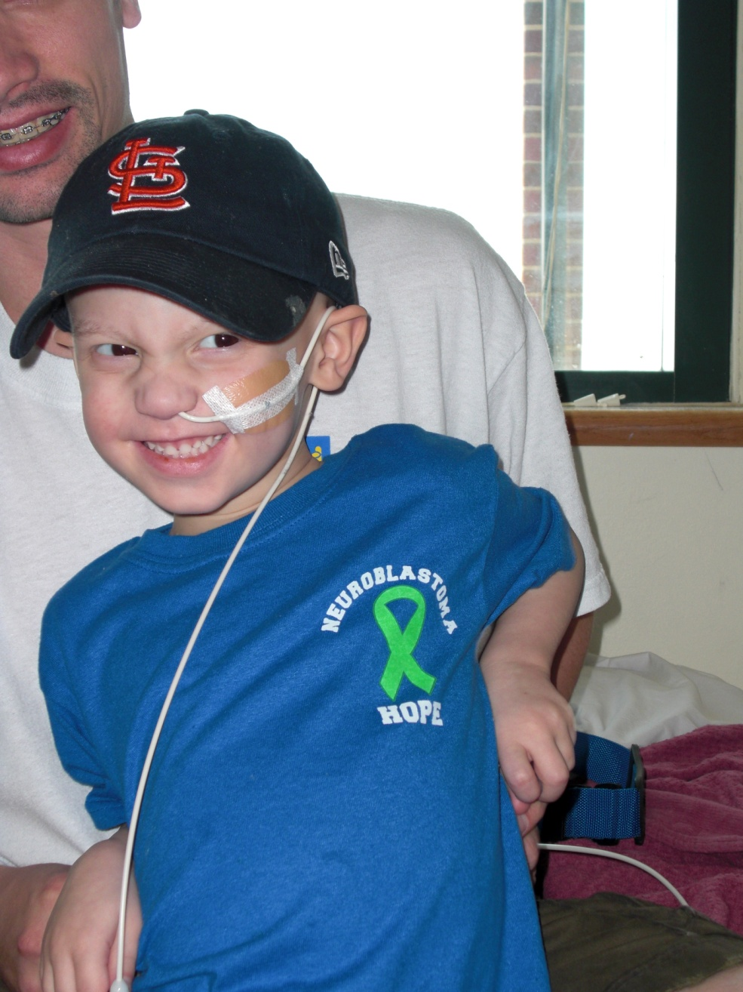
When I see you smile.
I can face the world
You know I can do
anything.
I see a ray of light
I see it shining right
through the rain.

Slide 15
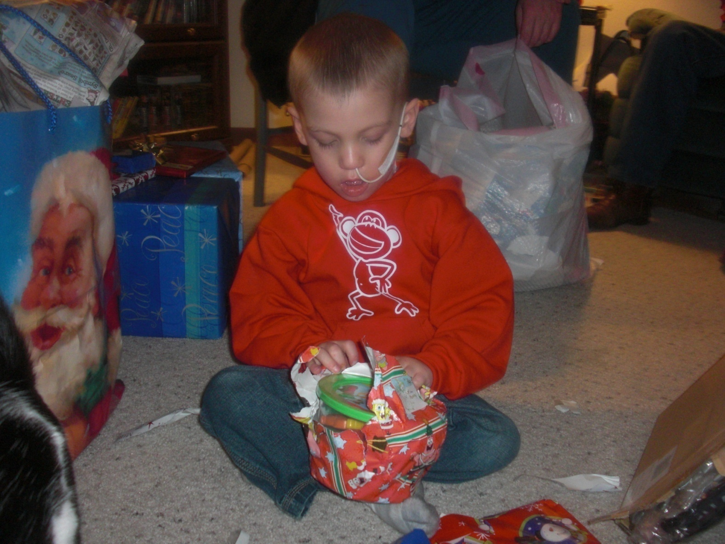
When I see you smile baby.
Baby when I see you smile.
Sometimes I wanna give up.
I wanna give in.

Slide 16
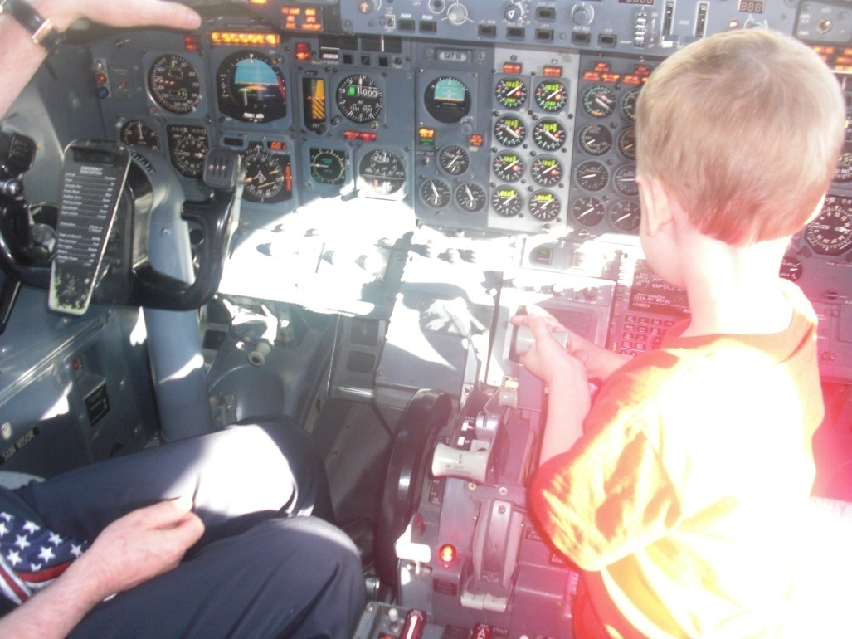
I wanna quit the fight.
Then one look at you baby.
And everything’s alright.

Slide 17
Everything’s alright.
It’s alright.
When I see you smile.
I can face the world.
When I see you smile.
I see a ray of light.
I see it shining right through the rain.
I can face the world.
You know I can do anything.

Slide 18
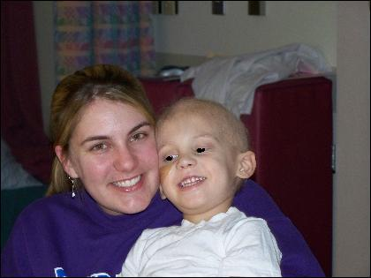
You know I can do anything now.
When I see you smile.
Baby when I see you smile.

Slide 19
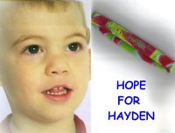
On March 15, 2009; a little boy was lost.
Hayden Dean “Monkey” Wion
2005-2009

Slide 20
He will be Forever Remembered

Slide 21
God looked around his garden,
And found an empty space.
He looked down upon the earth,
And saw your tired face.
He put his arms around you, and lifted you to rest.
God’s garden must be beautiful,
For he only takes the best.
He knows they you would never be well on earth again.
He saw the roads were getting tough,
And the hills were hard to climb.
So he closed your weary eyelids,
And whispered peace be thine.
Made in Memory of
Hayden D. Wion

